Slide 1
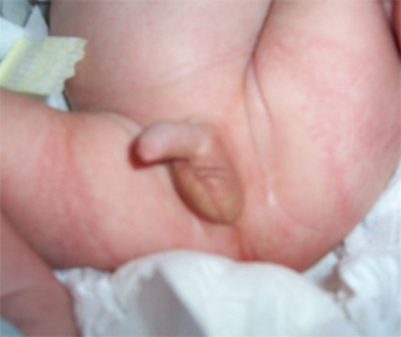
Clinical scenario 1
Premature, 2 Kg new born male baby of mother receiving gestational steroids is having empty right scrotum
Size and place of left testis is normal
Rest examination within normal limits.
What is your diagnosis?
When to treat?
How will you manage?
If surgery is required, what is right age?

Slide 2
Clinical scenario 2
30 year old male presents with mild pain and intra-abdominal lump in right lower abdomen
O/E Lump is hard, non tender, irregular, fixed, not moving with respiration
Right scrotum is empty
What is the diagnosis and why?
How will you manage?

Slide 3
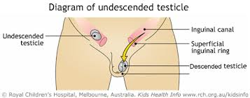
Undescended testes
Prof. Vinod Jain

Slide 4
Learning Outcomes
Be able to understand embryology of testicular descent & its application
Be able to suspect diagnosis based on clinical presentations
Be able to confirm diagnosis
Be able to prescribe correct treatment
Should understand logical approach of management
Be acquainted with complications

Slide 5
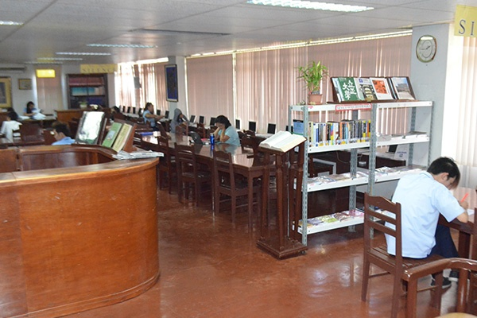
Learning resource material
Baily and Love’s Short practice of surgery (27th edition)
Campbell – Walsh Urology (12th edition)
www.clinicaluptodate.com
www.clinicalkey.com

Slide 6
Undescended Testes
Testicular embryology and normal descent
Time table of testicular descent
Incidence
Classification
Theories of maldescent
Endocrine factors
Gubernacular factors
Intra abdominal pressure

Slide 7
Undescended Testes
Histopathology
Clinical features
Hazards of incomplete descent
Investigations
Treatment
Hormone therapy
Surgical treatment

Slide 8
Embryology of testicular descent
SRY gene located on short arm of Y chromosome is responsible for testicular differentiation in 7th week of gestation
Testosterone from leydig cell and mullerian inhibiting substance (mis) from sertoli cells of fetal testes in 8th week initiate and sustain normal male development, independent of pituitary hormone regulation

Slide 9
Time table of testicular descent
In lumbar region – 2nd month of fetal life
In iliac fossa – 3rd month
At deep inguinal ring – till 7th month
Travels inguinal canal – in the 7th month
At superficial ring – 7th – 8th month
Scrotum (final position) – 9th month

Slide 10
Incidence
Isolated cryptorchidism – most common congenital anomaly at birth in male newborns
Affects 3% of full term male newborns
Unilateral is more common than bilateral
Right side more common then left side
70-77% descend spontaneously by 3 month of age
Incidence declines to 1% by 1 year of age and remains constant

Slide 11
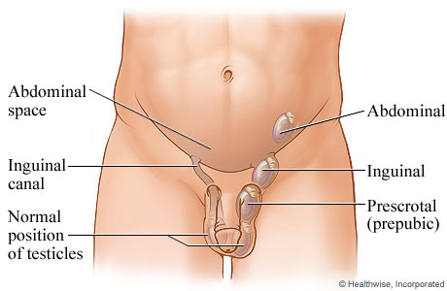
Classification
Intra-abdominal
Intracanalicular
Extracanalicular
Suprapubic
Infrapubic
Kaplan
Palpable – 80%
Nonpalpable – 20%

Slide 12
Factors for late testicular descent
Low birth weight - Principal determinant at birth
Preterm birth delivery, small for gestational age
Twin neonates
Cola consumption during pregnancy
Preeclampsia
Breech presentation
Complicated delivery
Familial factors

Slide 13
Gubernaculum and testicular descent
Gubernaculum develops in 7th week
Important role in fixation of testis to inguinal canal before descent
Definite role in descent is not obvious (testis can not be pulled to the scrotum)
Testicular descent is a complex process, mediated by both hormonal and mechanical factors

Slide 14
Testicular Descent
Testosterone and DHT necessary for descent in inguino-scrotal phase (2nd phase)
Descendin – an androgen independent factor (gubernacular specific growth factor)
Lowered intra-abdominal pressure
Prune belly syndrome
exomphalos

Slide 15
Histopathology
Changes are evident between 1-2 years of age
Changes include
Decreased number of leydig cells
Degeneration of sertoli cells
Delayed appearance of adult dark (AD) spermatogonia
Failure of primary spermatocyte to develop
Reduced total germ cell counts

Slide 16
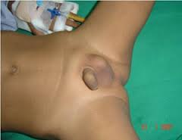
Clinical features
Absent testis in normal position
Soft and small if palpable
May be associated with hernia or hydrocele
Preterm and maternal history
Gestational steroids
Family history
Documentation of undescended testis at the time of birth

Slide 17
Terms in undescended Testis
Non-palpable
Vanishing
Atrophic
Retractile

Slide 18
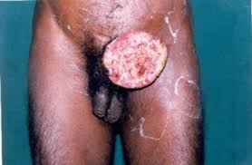
Hazards of incomplete descent
Infertility
Pain due to trauma
Associated indirect inguinal hernia
Testicular torsion
Testicular atrophy
Testicular tumour

Slide 19
Investigations
Radiology – USG, CT Scan, MRI, herniography
Endocrine evaluation FSH, LH, HCG, Testosterone, DHT
hCG stimulation test

Slide 20
hCG stimulation test
Baseline testosterone level
hCG 2000 units daily x 4 days
Estimate testosterone on 5th day
10 times increased testosterone if testes are present

Slide 21
Management aims
Proper identification of anatomy, position and viability of undescended testis
Timely placement of testis with in scrotum to further prevent impairment in fertility potential or endocrine function (6 month to 1 year)
Permanent fixation for easy palpation
No further testicular damage resulting from the treatment

Slide 22
Hormone therapy
Exogenous hCG (Structurally analogue to LH) – stimulates leydig cells directly to promote secretion of testosterone
Exogenous GnRH or LHRH – Stimulates pituitary to release LH – promotes testicular testosterone production
Lower the pretreatment level better the success rate

Slide 23
Hormone therapy
Optimal age is 5 years
More effective in bilateral than unilateral
Exogenous hCG – 1500 IU/M² IM twice a week for 4 weeks
Exogenous GnRH – 1.2 mg / day nasal spray for 4 weeks
Testis will descent in a month time in 10-20%

Slide 24
Hormone therapy
Not indicated in
Patients with previous surgery for testis
Patients with inguinal surgery
Immune suppressed patients
Overall efficacy
<20%
Significantly dependent on pretreatment testicular location
Surgery remains gold standard treatment

Slide 25
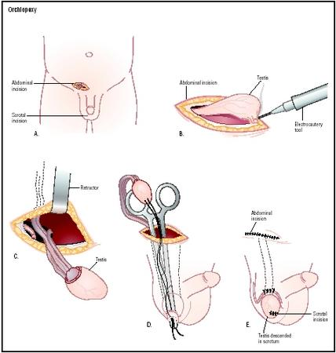
Surgical treatment
Standard orchiopexy
Laparoscopic orchiopexy
Microvascular auto transplantation
Contra-lateral orchiopexy (prophylactic)

Slide 26
Surgical treatment – standard orchiopexy
Key steps -
Complete mobilization of testes and spermatic cord
Repair of procesus vaginalis by high ligation of hernia sac
Skeletonization of spermatic cord without sacrificing vascular integrity
Creation of superficial pouch in hemiscrotum

Slide 27
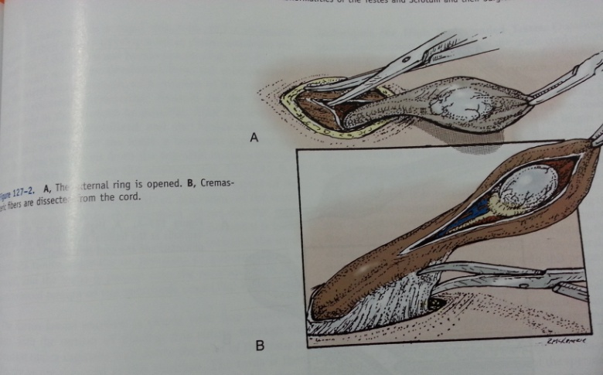
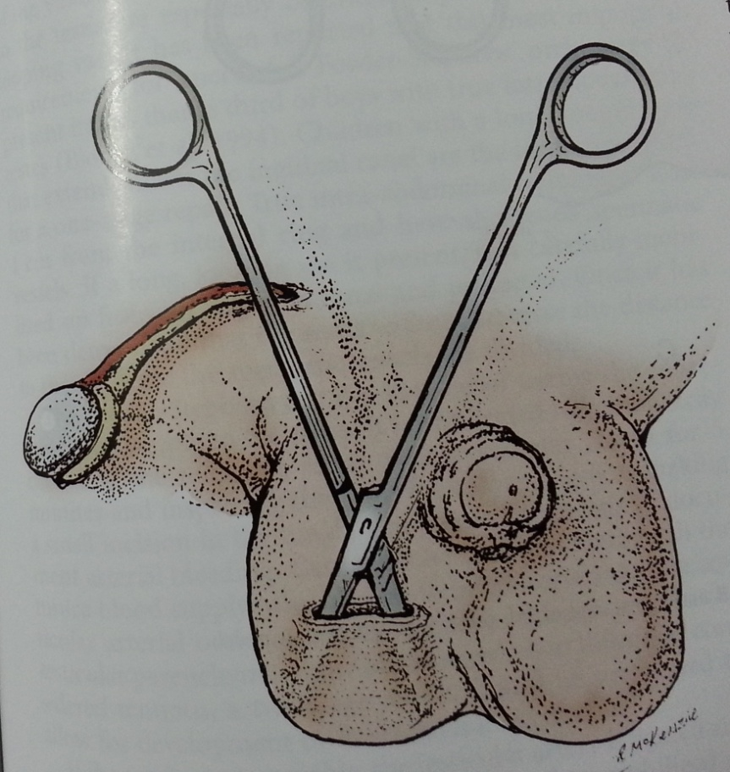
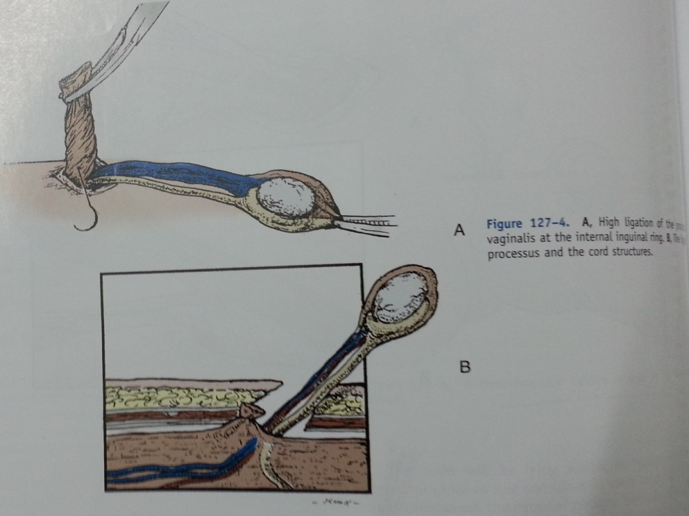

Slide 29
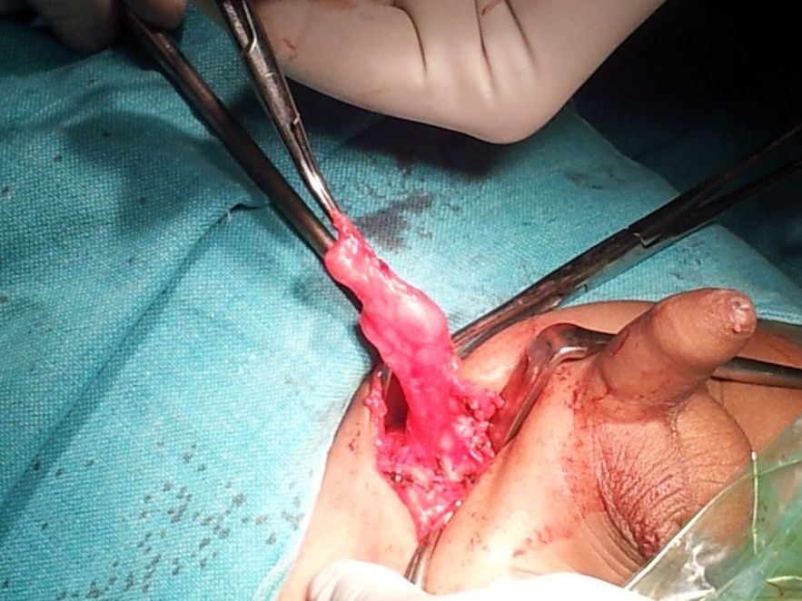
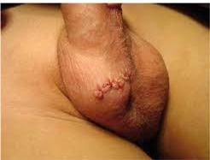
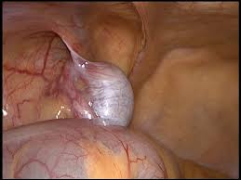

Slide 30
Complications of orchiopexy
Testicular retraction
Heamatoma formation
Wound infection
Ilioinguinal nerve injury
Post operative torsions
Damage to vas deferens
Testicular atrophy

Slide 31
Indication of Orchiectomy
In post pubescent males with –
Contralateral normally descended testis and morphologically and anatomically abnormal cryptorchid testis
Too far from scrotum to be placed without compromising the vascular supply

Slide 32
Interdisciplinary Linkage?
Surgery/Urology
Pathology
Radiodiagnosis and nuclear medicine
Radiotherapy
Surgical oncology
Medical oncology
Paramedics and health workers

Slide 33
Any Questions
?

Slide 34
Let us revise
Testicular embryology and normal descent
Time table of testicular descent
Incidence
Classification
Theories of maldescent
Endocrine factors
Gubernaculum factors
Intra abdominal pressure
Histopathology
Clinical features
Hazards of incomplete descent
Investigations
Treatment
Hormone therapy
Surgical treatment

Slide 35
Clinical scenario 1
Premature, 2 Kg new born male baby of mother receiving gestational steroids is having empty right scrotum
Size and place of left testis is normal
Rest examination within normal limits.
What is your diagnosis?
When to treat?
How will you manage?
If surgery is required, what is right age?

Slide 36
Clinical scenario 2
30 year old male presents with mild pain and intra-abdominal lump in right lower abdomen
O/E Lump is hard, non tender, irregular, fixed, not moving with respiration
Right scrotum is empty
What is the diagnosis and why?
How will you manage?

